Slide 1
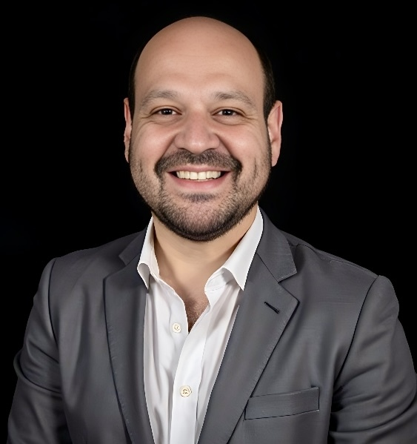

Driving Customer Success & Digital Transformation
More than 27 years driving cloud adoption and digital transformation for enterprise customers. Expert in managing Fortune 500 accounts, expanding portfolios, and leading C-suite engagements to accelerate innovation and growth.
by Raymond Otero

Slide 2

Career Achievements
1
Account Growth Excellence
Led global customer success for Fortune 500 clients. Expanded accounts by 36% year-over-year from 2021-2024.
2
Consistent Target Achievement
Orchestrated cross-cloud consumption plans aligned with customer goals. Exceeded 115% attainment year-over-year from 2020-2024.
3
Strategic Relationship Building
Fostered executive sponsorships and managed C-suite relationships. Established joint governance models improving performance.

Slide 3

Core Expertise
Strategic Field Leadership
Cloud Transformation & Sales
Expert in field selling strategies, executive stakeholder engagement, and strategic account management. Led cross-functional teams to implement customer-centric sales initiatives across territories.
Pioneered cloud technology sales strategies and digital transformation initiatives. Developed joint operating models and revenue-generating frameworks for Fortune 500 clients.
Field-Driven Customer Success
Analyzed on-site customer feedback to identify market trends. Developed field-tested solutions improving overall sales effectiveness, user experience, and client retention.

Slide 4

Microsoft & AWS Leadership Journey
Director, Global Customer Experience
May 2024 - Present. Leading global customer experience strategies and high-impact teams. Pioneering innovative approaches to enhance engagement.
Global Customer Solutions Sr. Mgt.
Jan 2018 - Oct 2021. Led cloud transformation initiatives at AWS. Established Centers of Excellence optimizing operations.
1
2
3
Senior Principal, Customer Success
Oct 2021 - May 2024. Led strategic account management for Fortune 500 clients. Orchestrated cross-cloud adoption plans.

Slide 5





Strategic Account Management
Account Analysis
Assessed customer needs and identified strategic opportunities. Created tailored cloud adoption roadmaps.
Relationship Building
Cultivated Chief-level relationships. Influenced strategic roadmap decisions securing long-term commitments.
Growth Execution
Orchestrated cross-cloud consumption plans. Expanded revenue streams through partner collaboration.
Success Measurement
Tracked Key Performance Indicators and Return on Investment. Implemented joint governance models improving account performance.

Slide 6




Cloud Transformation Leadership
Strategic Planning
Centers of Excellence
Developed comprehensive cloud strategies aligned with business objectives.
1
Established governance structures optimizing cloud operations and efficiency.
2
Continuous Optimization
4
Solution Implementation
Refined approaches based on analytics and customer feedback.
3
Delivered measurable outcomes through targeted cloud solutions.

Slide 7




Industry Experience
Financial Services
Manufacturing
Healthcare/Life Sciences
Federal
Led cloud transformation initiatives for major banking and insurance clients. Specialized in regulatory compliance solutions.
Mentored Manufacturing Customer Success Account Management team. Conducted Consumption Community Coaching for industrial clients.
Navigated complex government procurement processes. Delivered secure cloud environments for federal agencies.
Implemented secure cloud solutions for sensitive patient data. Enabled digital innovation in healthcare delivery.

Slide 8




Education & Professional Development
Advanced Education
Technical Expertise
Recognition
Global Customer Success Leader of the Year Finalist 2024. Multiple Organization Team Awards for excellence.
Cornell University: Master Certificates in Executive Leadership & Financial Management
MS in Information Technology from Capella University. BS in Information Technology from University of Phoenix.

Slide 9
Leadership Philosophy
Customer-Centric Approach
Strategic Vision
Team Empowerment
Every strategy begins with understanding customer needs. Solutions must deliver measurable business outcomes that matter.
Aligning technology initiatives with business objectives creates lasting value. Long-term partnerships outperform transactions.
Success comes from building high-performing teams. Mentoring develops future leaders who drive innovation.

Slide 10




Ready to Drive Your Field Selling Success
Revenue Growth
Executive Relationships
Transformation Leadership
Team Development
Exceeding targets through strategic selling
Building high-performing sales organizations
C-suite engagement driving long-term value
Guiding digital journeys with measurable outcomes
My consistent record demonstrates excellence in strategic selling approaches that expand customer portfolios. I am skilled at establishing partnerships at the executive level that create lasting business value. As a transformation leader, I guide organizations through their digital evolution with concrete results. Through mentoring and enablement, I develop teams that consistently deliver exceptional performance.

Slide 11

Thank You
Thank you for considering my candidacy. My career has been fueled by a deep passion for harnessing cutting-edge technologies to transform complex business challenges into strategic advantages.
I am excited about the opportunity to discuss how my sales expertise and field leadership experience can drive innovation and deliver exceptional results for your team.

