Slide 1

RAYMOND OTERO
Executive Leader – Operational & Customer Transformation
Driving organizational excellence through disciplined execution, scalable systems, and enterprise alignment

Slide 2

Strategic Operator with Proven Impact
Strategic operator with 27+ years leading transformation across global enterprises in cloud, AI, and customer experience. Proven record of translating vision into measurable results by architecting frameworks that drive speed, precision, and accountability.
Contact
Ambler, PA
rayotero323@gmail.com
LinkedIn Profile
Trusted by C-suite leaders to modernize operations, reengineer processes, and deliver sustainable growth. Experienced in multi-billion-dollar portfolios, organizational restructuring, and global execution at scale.

Slide 3



Rackspace Alignment: Perfect Strategic Fit
Strategic Execution
Operational Excellence
Cross-Functional Leadership
Translated Microsoft and AWS strategic priorities into global CX operating models influencing $200M+ renewals and $50M+ expansion.
Designed and scaled RoB, KPI, and accountability systems across 1,500+ enterprise accounts, improving CSAT 20% and retention 15%.
Directed 120+ cross-org stakeholders at AWS, uniting sales, product, and service teams under unified operational rhythm.
Transformation & Change
Metrics & Performance
Team Development
Led cloud modernization and AI-integrated CX transformations, embedding governance and data insights across regions. Built executive engagement models reducing churn 18% YoY.
Built KPI frameworks, dashboards, and predictive analytics models enabling data-informed decisions and operational accountability.
Mentored senior leaders and architects globally; built multi-disciplinary teams that scaled operational maturity and execution precision.

Slide 4

Microsoft Corporation: Driving Enterprise CX Transformation
1
2024 – Present
Director, Global Customer Experience – Strategic Programs
2
2021 – 2024
Senior Principal, Customer Success Director
Current Role Highlights
Previous Role Achievements
Directed enterprise-wide CX transformation programs impacting $200M+ renewals
Oversaw $200M SaaS portfolio; exceeded adoption targets at 115%
Architected operational governance systems accelerating strategic delivery by 25%
Unlocked $50M in expansion revenue through strategic frameworks
Increased field certifications 45% via technical enablement strategy
Partnered with Sales, Product, and Support to embed AI-driven insights
Improved retention by 15% through operational health metrics
Achieved 18% reduction in churn YoY through predictive analytics

Slide 5
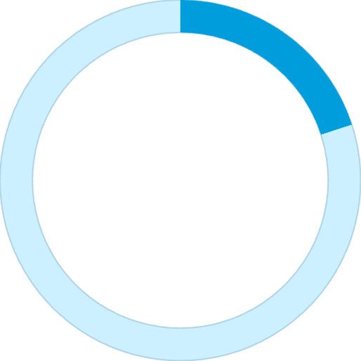
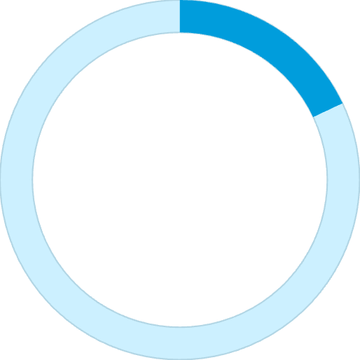
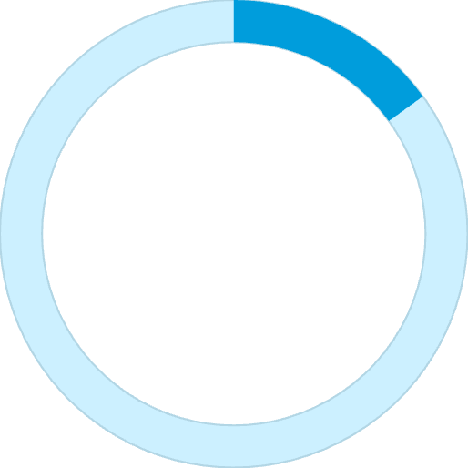
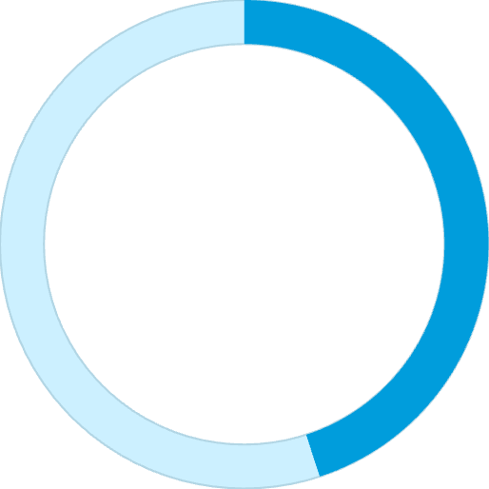
Measurable Impact Across the Enterprise
$200M+
$50M+
25%
Portfolio Value
Expansion Revenue
Delivery Acceleration
Renewals influenced through CX transformation programs
Unlocked through strategic operational frameworks
Improvement in strategic delivery speed
20%
18%
CSAT Improvement
Churn Reduction
Across 1,500+ enterprise accounts
Year-over-year through predictive analytics
15%
45%
Retention Lift
Certification Growth
Via accountability systems and KPI frameworks
Field enablement and technical readiness

Slide 6

AWS: Leading Global Financial Services Transformation
Global Customer Solutions Senior Manager, Financial Services Industry (2018 – 2021)
Led 120+ cross-functional leaders across sales, services, and partners, managing $500M+ FSI portfolio. Streamlined execution through partner ecosystem integration, driving 40% growth in adoption efficiency.
Served as escalation lead for global top-tier accounts, influencing board-level operational recovery initiatives and establishing governance frameworks that became organizational standards.
$500M+ Portfolio
120+ Leaders
40% Growth
Managed across Financial Services Industry vertical
Cross-functional coordination across sales, services, partners
Adoption efficiency through ecosystem integration

Slide 7



Consulting Leadership: Scaling Cloud & Technology Operations
Comport Consulting
VP, Cloud & Emerging Technologies (2017 – 2018)
Owned P&L for cloud/tech division; drove 30% YoY revenue growth via process improvement and operational optimization.
Anexinet (Verinext)
Senior Manager, EUC & Infrastructure (2013 – 2017)
Scaled EUC operations across enterprise clients, delivering 25% YoY growth and 20% faster project delivery.
Created standardized delivery playbooks and process efficiencies that improved onboarding timelines, client satisfaction, and team capacity across multiple enterprise engagements.

Slide 8




Education & Professional Certifications
Cornell University
Capella University
Executive Leadership & Financial Management Certificates
M.S. Information Technology
University of Phoenix
Community College of the Air Force
B.S. Information Technology
A.A.S. General Studies
Professional Certifications
Raymond holds 20+ accreditations and certifications from PMI, Microsoft, Google, AWS, Citrix, CompTIA, and IDEO-U.

Slide 9





Core Competencies & Technical Skills
Operational Transformation
OKR/KPI Frameworks, Process Reengineering, Governance & RoB Design, Continuous Improvement Culture
Leadership Excellence
Cross-Functional Leadership, Program Management, Organizational Change, P&L Oversight
Data & Analytics
AI & Analytics Integration, Data-Driven Decisioning, Predictive Analytics, KPI Dashboards
Cloud Platforms
Azure, AWS, Cloud Modernization, Enterprise Architecture, SaaS Operations

Slide 10

Recognition & Awards
Global Customer Success Leader of the Year
Customer Success Leader to Watch
Finalist (2024)
Industry Recognition (2025)
Microsoft Worldwide CS Leadership Team
CSAM Innovate Leader
AWS Global Financial Services
Customer Obsession Award
U.S. Air Force
Achievement Medal (Honorable Discharge)
"Operational Transformation Executive driving scalable execution, alignment, and growth across global enterprises"

